Slide 1
Chapter 19
Binary Search Trees

Slide 2
Chapter Outline
For large amounts of input, the linear access time of linked lists is prohibitive. In this chapter we look at an alternative to the linked list: the binary search tree, a simple data structure that can be viewed as extending the binary search algorithm to allow insertions and deletions. The running time for most operations is O(log N) on average. Unfortunately, the worst-case time is O(N) per operation.
In this chapter, we show
The basic binary search tree
A method for adding order statistics (i.e., the findKth operation)
Three different ways to eliminate the O(N) worst case (namely, the AVL tree, red-black tree, and AA-tree)
Implementation of the Collections API TreeSet and TreeMap
Use of the B-tree to search a large database quickly

Slide 3
Basics
B-Trees must be able to be sorted (comparable). Meaning, things on the left tree are smaller, and things on the right are larger
binary search tree order property
In a binary search tree, for every node X, all keys in X’s left subtree have smaller values than the key in X, and all keys in X’s right subtree have larger values than the key in X.

Slide 4
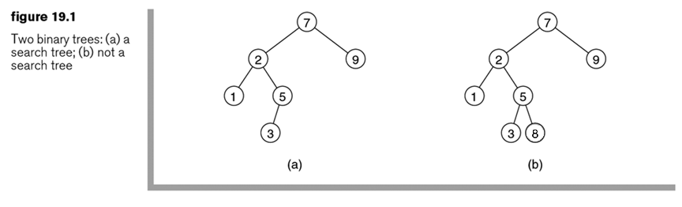
Are these binary search trees?
Move for answer

Slide 5
Methods
findMin
How does this work?
findMax
How does this work?
What are the Big-Oh times?
Worst case on a poorly designed tree?

Slide 6
Remove method
How do you remove a node from the tree?
If it is a leaf?
If it has children?
Can you design some hard problems with children we can think about?

Slide 7
Insertion?
Can you think of how we can insert items and where they should be placed?

Slide 8
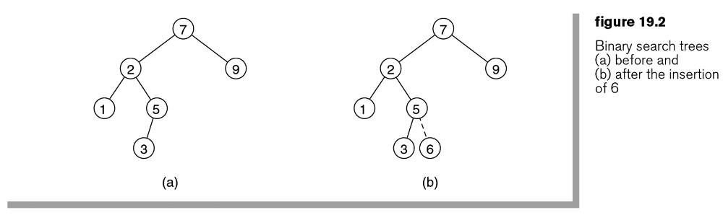
Add 6 into this tree
Move for answer

Slide 9
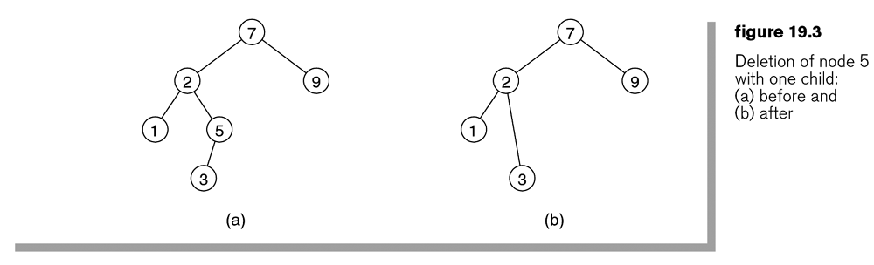
Remove 5 from the following tree
Move for answer
What changes if 5 has two children?
If it has entire subtrees?

Slide 10
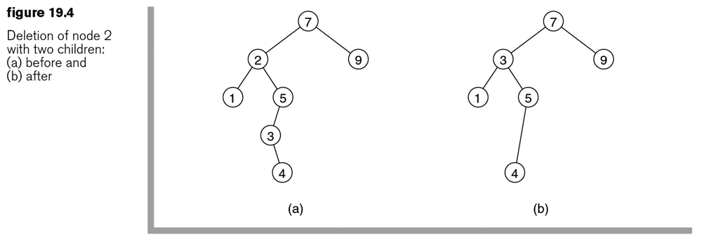
2 Children – Smart choice
Pick the smallest child on the right, and move it into position of the node you are deleting
If it has a right child, attach it
(why not a left?)

Slide 11
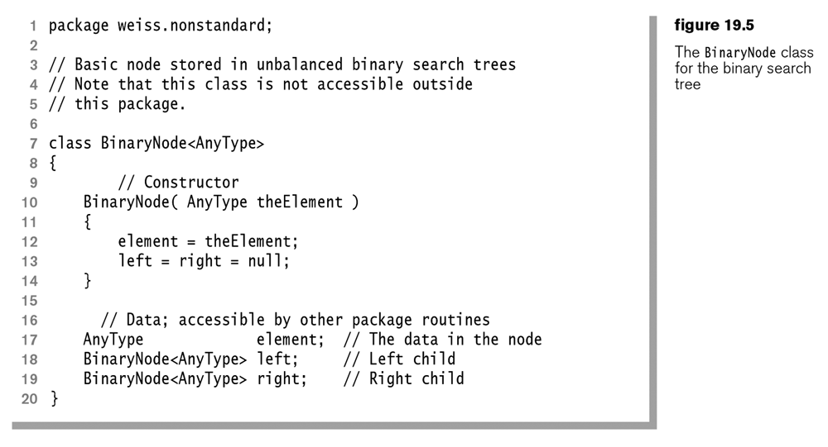

Slide 12
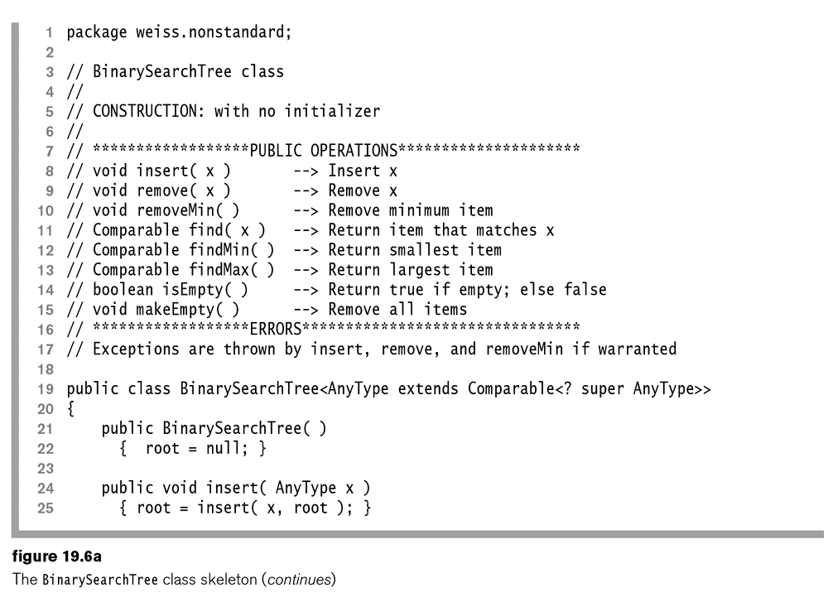

Slide 13
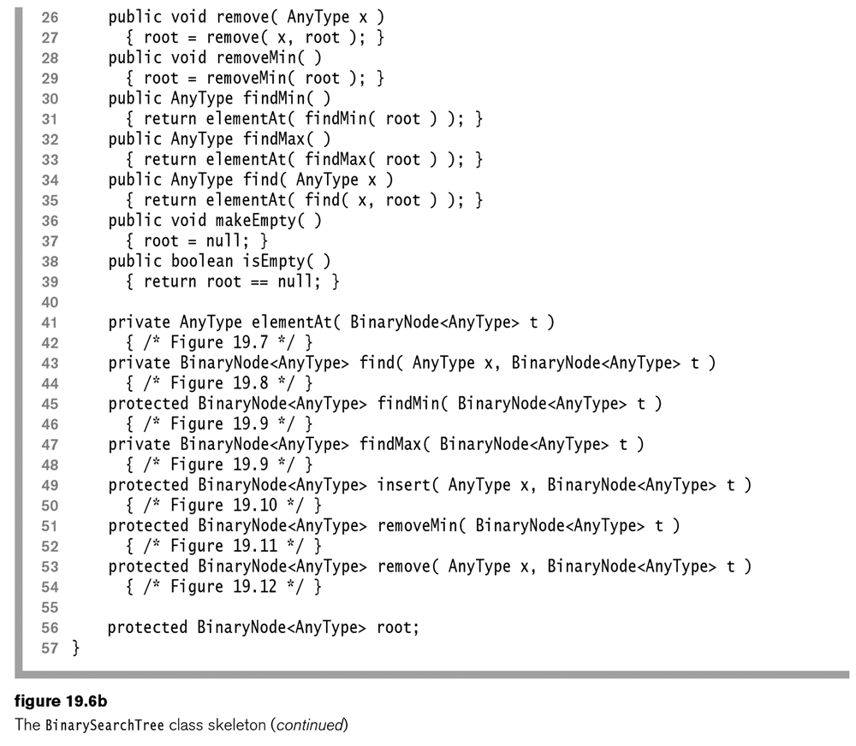

Slide 14
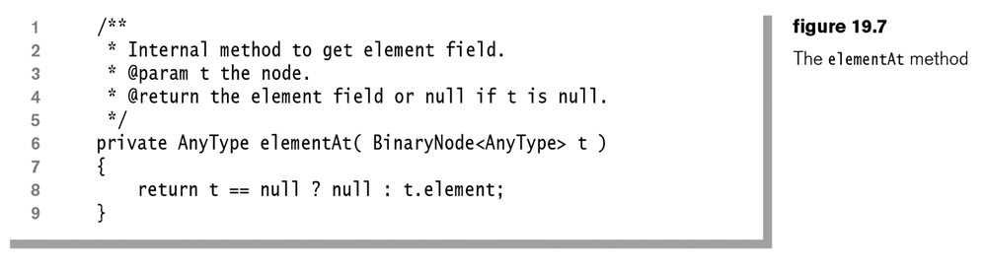

Slide 15
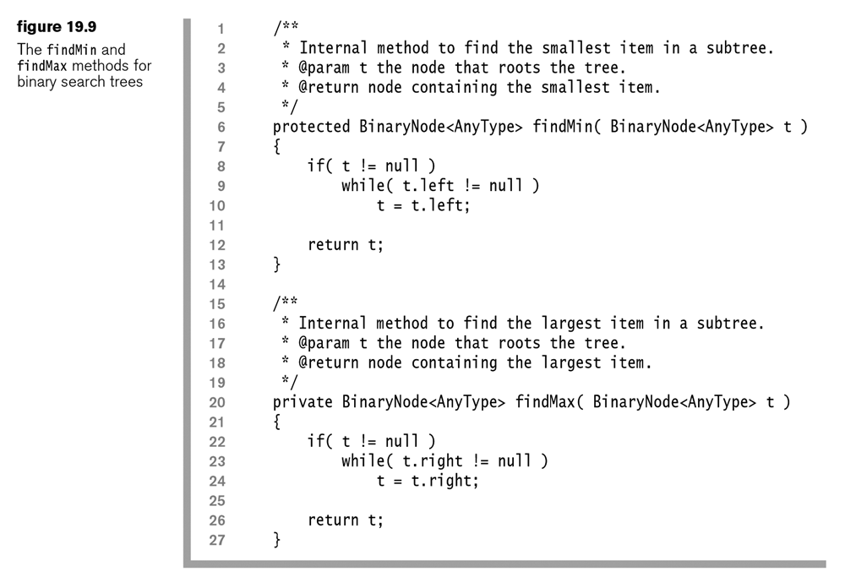
Let’s Code It Up - findMin
Code up the findMin method in the BinarySearchTree.java file
Do it iteratively, as the homework asks for a recursive solution

Slide 16
findMin

Slide 17
Let’s Code It Up - findMax
Code up the findMax method in the BinarySearchTree.java file
Do it iteratively, as the homework asks for a recursive solution

Slide 18
findMax

Slide 19
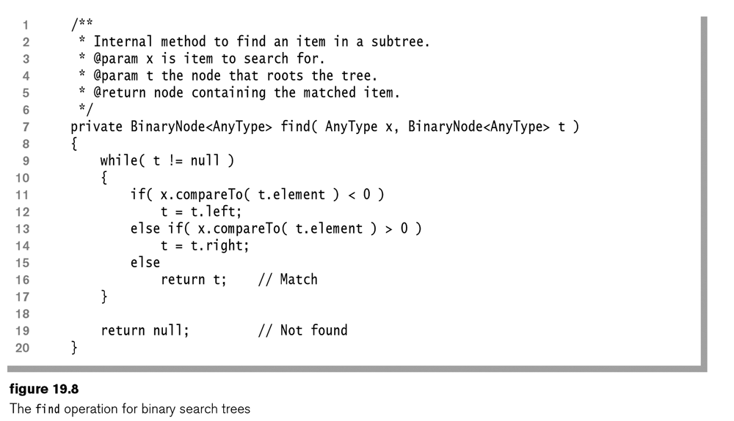
Let’s Code It Up - Find
Code up the Find method in the BinarySearchTree.java file
Do it iteratively, as the homework asks for a recursive solution

Slide 20
find

Slide 21
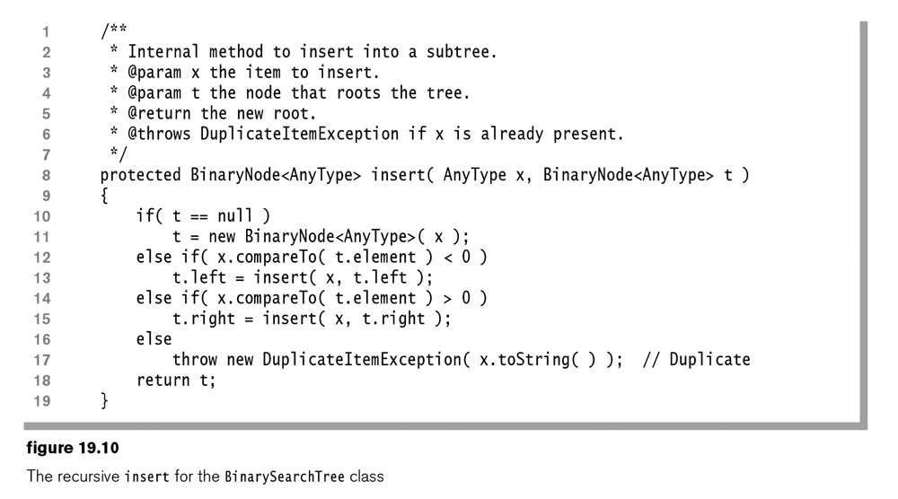
Let’s Code It Up - Insert
If we are feeling up to it, let’s code up the insert method
Try with using recursion, as it isn’t a homework problem

Slide 22
Insert
“The insert routine is shown in Figure 19.10. Here we use recursion to simplify the code. A nonrecursive implementation is also possible; we apply this technique when we discuss red–black trees later in this chapter.
The basic algorithm is simple. If the tree is empty, we can create a one-node tree. The test is performed at line 10, and the new node is created at line 11. Notice carefully that, as before, local changes to t are lost. Thus we return the new root, t, at line 18.
If the tree is not already empty, we have three possibilities. First, if the item to be inserted is smaller than the item in node t, we call insert recursively on the left subtree. Second, if the item is larger than the item in node t, we call insert recursively on the right subtree (these two cases are coded at lines 12 to 15). Third, if the item to insert matches the item in t, we throw an exception. “

Slide 23
The Insert Method

Slide 24
Let’s Code It Up -
If we are up for it, let’s code up the following methods:
removeMin
remove

Slide 25
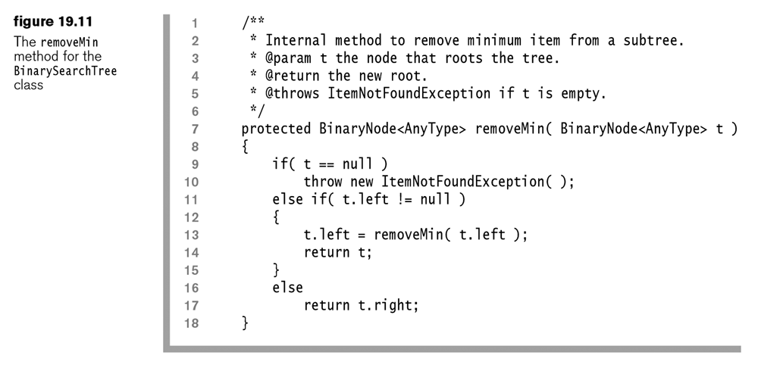
The removeMin Method
Uses recursion to avoid keeping track of the parent node

Slide 26
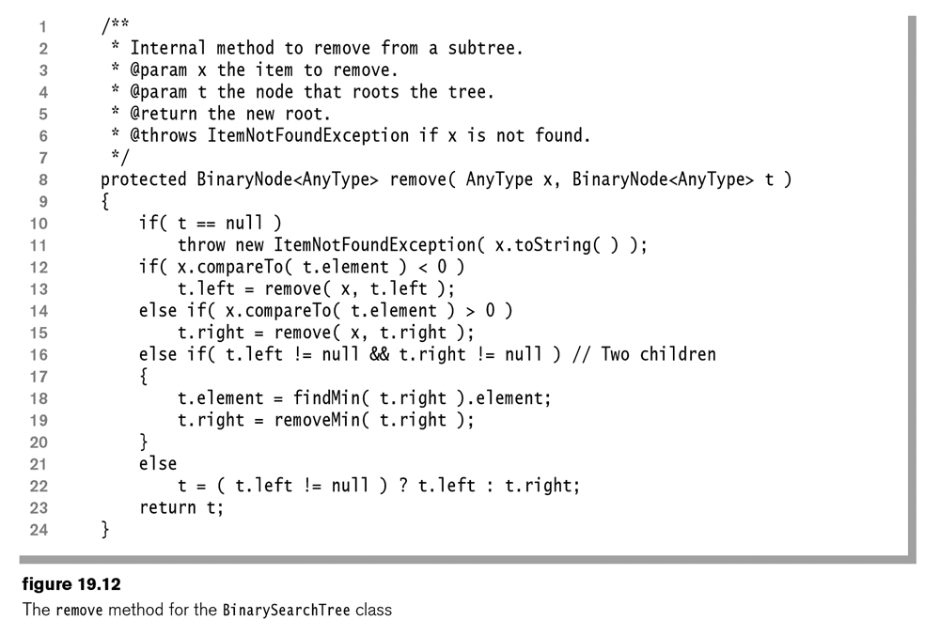
Remove method

Slide 27
Big_Oh
What is the time to:
Insert?
Remove?
Find?
What if you wanted to find the kth element?
What is a possible algorithm, and how might you need to change the data structures?
What is the time of your algorithm?

Slide 28
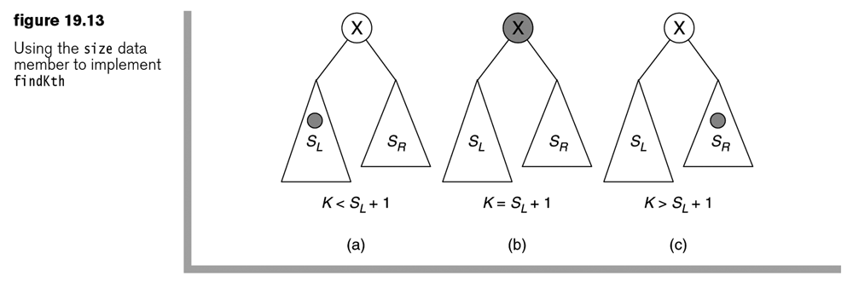
Find the Kth item
Idea: Add a size instance variable
How does this variable change with insert?
With remove?

Slide 29
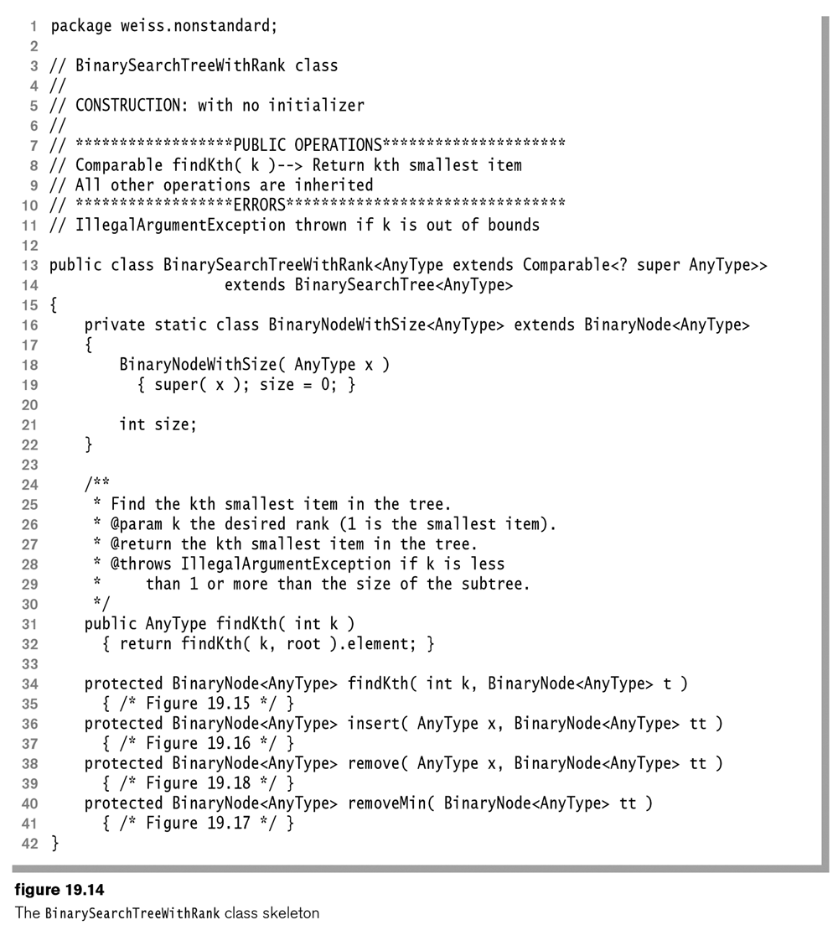

Slide 30
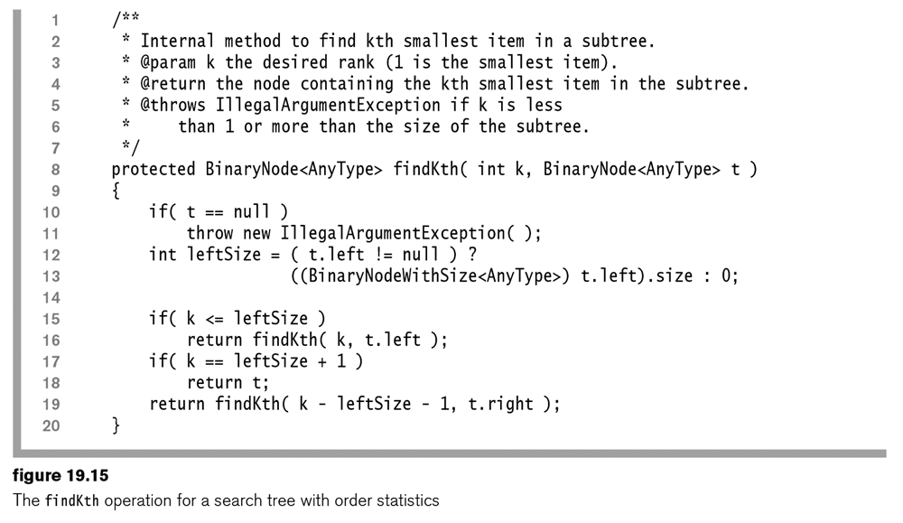
findKth method

Slide 31
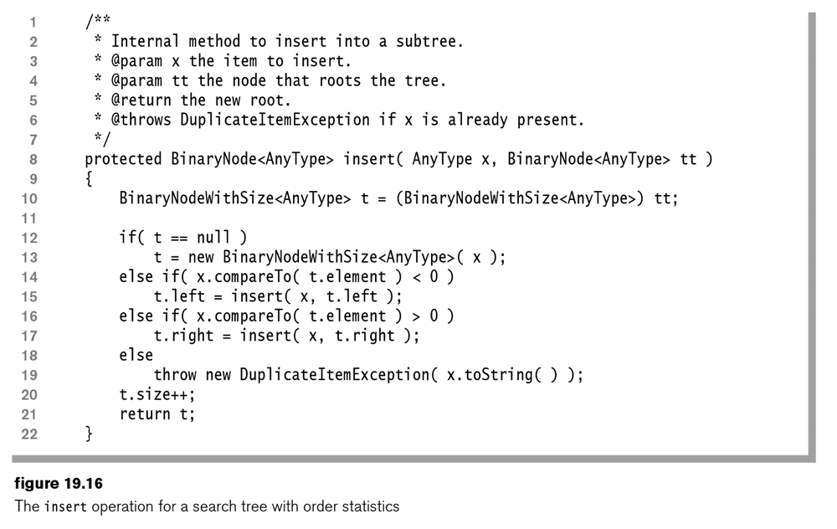
Insert method

Slide 32
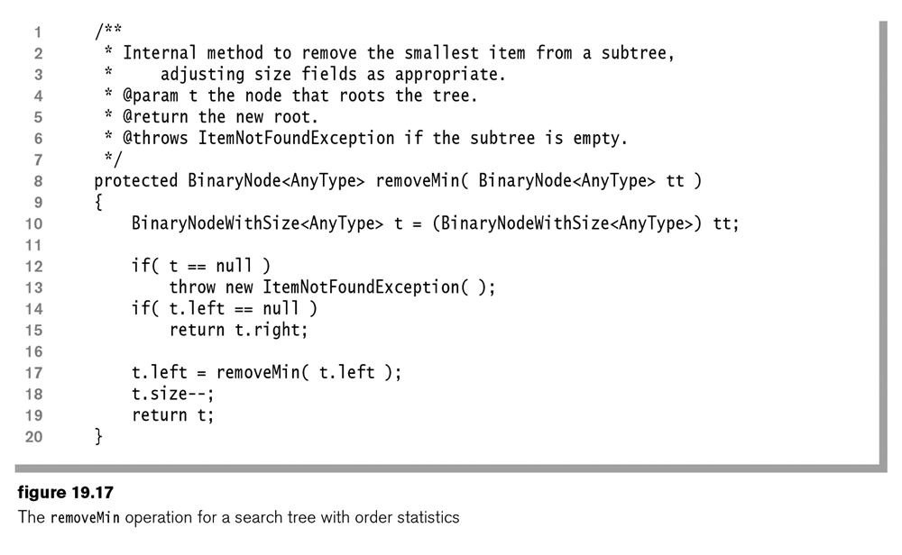
removeMin method

Slide 33
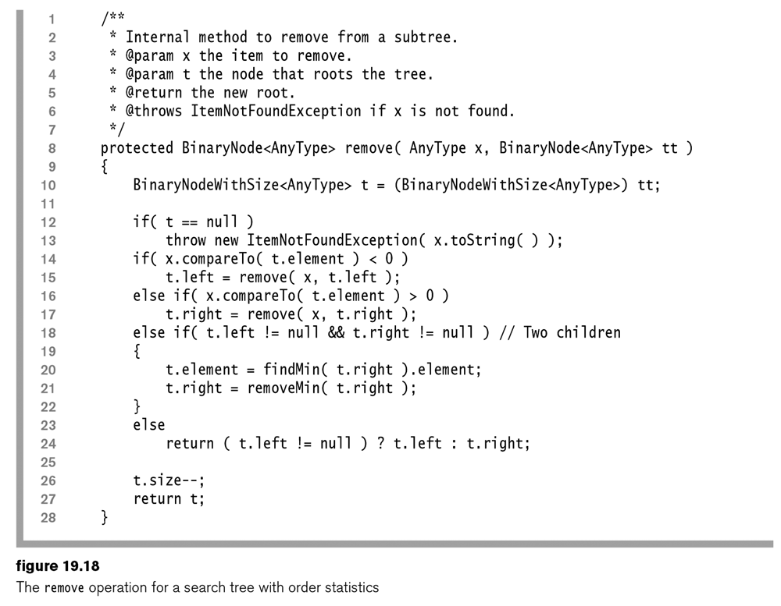
Remove Method

Slide 34
Big Oh
Now that we know the basics of a Binary Tree, let’s talk about how we can make things faster

Slide 35
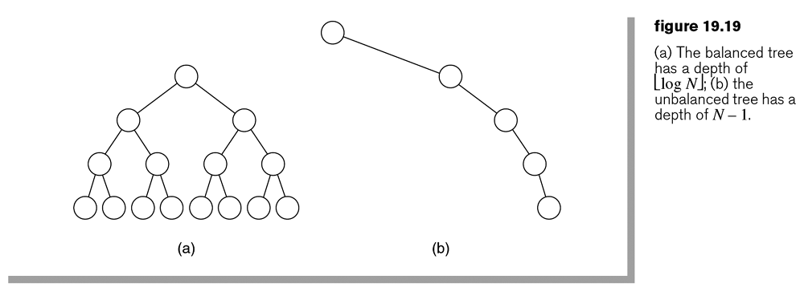
Balanced vs unbalanced
What is the Big_Oh of these trees?
For the find method
Note: The right picture might be considered a linked list

Slide 36
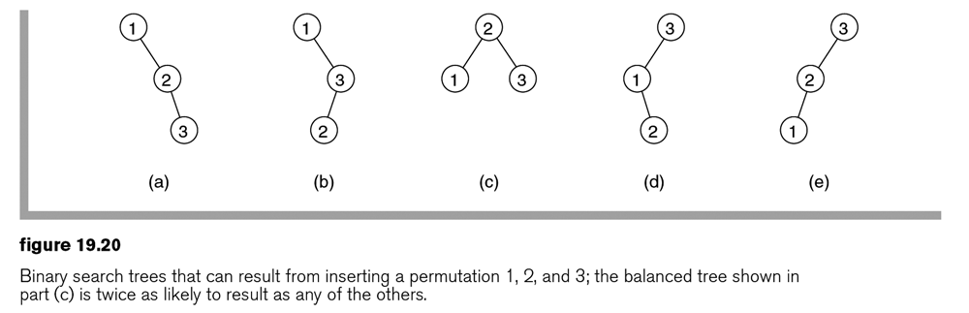
Random Inserts
Pick 1,2 and 3 in random order, and perform an insert with them into a Binary Tree. Draw a picture showing the tree.
How many different trees?
What are the probabilities of getting each tree?
Move for answer

Slide 37
Theorem 19.1
The internal path length of a binary search tree is approximately 1.38 N log N on average, under the assumption that all permutations are equally likely.
Let D(N) be the average internal path length for trees of N nodes, so D(1) = 0. An N- node tree T consists of an i-node left subtree and an (N – i – 1)-node right subtree, plus a root at depth 0 for 0 ≤ i < N. By assumption, each value of i is equally likely. For a given i, D(i) is the average internal path length of the left subtree with respect to its root. In T, all these nodes are one level deeper. Thus the average contribution of the nodes in the left subtree to the internal path length of T is (1 ⁄ N)∑N – 1 D(i) , plus 1 for each node in the left subtree. The same holds for the right subtree. We thus obtain the recurrence formula D(N) = (2 / N)(∑N – 1 D(i) ) + N – 1, which is identical to the quicksort recurrence solved in Section 8.6. The result is an average internal path length of O(N log N).

Slide 38
Theorem 19.2
definition: The external path length of a binary search tree is the sum of the depths of the N + 1 null links. The terminating null node is considered a node for these purposes.
Theorem: For any tree T, let IPL(T) be the internal path length of T and let EPL(T) be its external path length. Then, if T has N nodes, EPL(T) = IPL(T) + 2N.
This theorem is proved by induction and is left as Exercise 19.7.

Slide 39
Randomness
Trees are only mostly balanced on random insertions. What happens if the data is sorted and then we insert it into a tree?
What can we do?
Change the insert method?
Add a method that balances the tree?

Slide 40
So
That leads us to a data structure that makes sure the tree remains mostly balanced

Slide 41
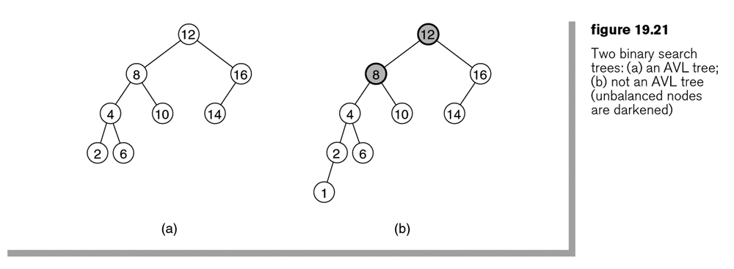
AVL Trees (Adelson-Velskii and Landis)
Definition: An AVL tree is a binary search tree with the additional balance property that, for any node in the tree, the height of the left and right subtrees can differ by at most 1. As usual, the height of an empty subtree is –1.
What happens to the left tree with an insert of 13?

Slide 42
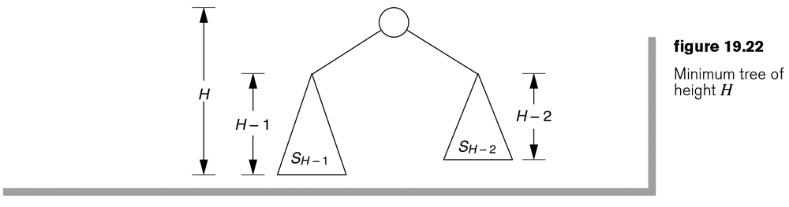
Proof of Log(N)
The AVL balance condition implies that the tree has only logarithmic depth. To prove this assertion we need to show that a tree of height H must have at least CH nodes for some constant C > 1. In other words, the minimum number of nodes in a tree is exponential in its height. Then the maximum depth of an N-item tree is given by log_{C}N. Theorem 19.3 shows that every AVL tree of height H has many nodes.

Slide 43
Takeaway on AVL
the worst-case height of an AVL Tree is at most roughly 44 percent more than the minimum possible for binary trees.
Operations that change the tree, such as insert and remove, are not quite as simple as before. We will explore those next

Slide 44
Theorem 19.3
An AVL tree of height H has at least F_{H + 3} – 1 nodes, where F_{i} is the ith Fibonacci number (see Section 7.3.4).
Let S_{H} be the size of the smallest AVL tree of height H. Clearly, S₀ = 1 and S₁ = 2. Figure 19.22 shows that the smallest AVL tree of height H must have subtrees of height H – 1 and H – 2. The reason is that at least one subtree has height H – 1 and the balance condition implies that subtree heights can differ by at most 1. These subtrees must themselves have the fewest number of nodes for their heights, so S_{H} = S_{H – 1} + S_{H – 2} + 1. The proof can be completed by using an induction argument.

Slide 45
Insert - Rebalance
Because any node has at most two children and a height imbalance requires that the heights of X’s two subtrees differ by 2, a violation might occur in any of four cases:
An insertion in the left subtree of the left child of X
An insertion in the right subtree of the left child of
An insertion in the left subtree of the right child of X
An insertion in the right subtree of the right child of X
The first case, in which the insertion occurs on the outside (i.e., left–left or right–right), is fixed by a single rotation of the tree. A single rotation switches the roles of the parent and child while maintaining search order. The second case, in which the insertion occurs on the inside (i.e., left–right or right–left), is handled by the slightly more complex double rotation.
Try it on a simple tree – Can we make one up?

Slide 46
Supplement
The book isn’t super clear on the following rotations, so I found additional material online and included it for the AVL Tree – Hopefully on the G: drive
But we can work through the following slides first

Slide 47
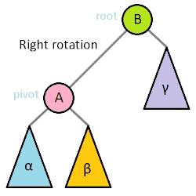
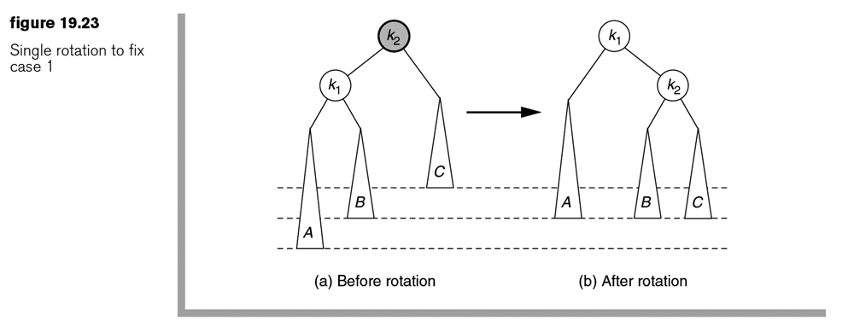
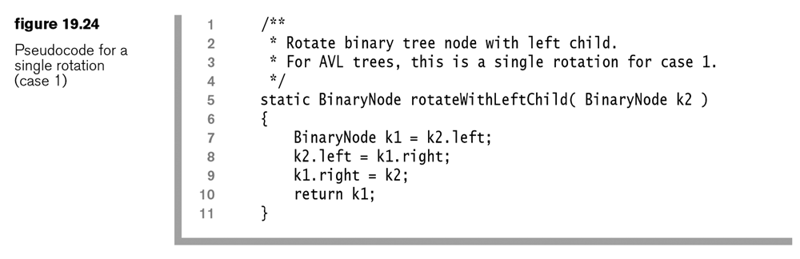
Single Rotation Example
Wikipedia.org

Slide 48
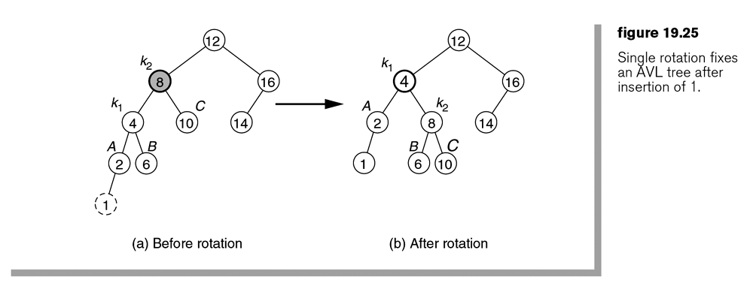

Slide 49
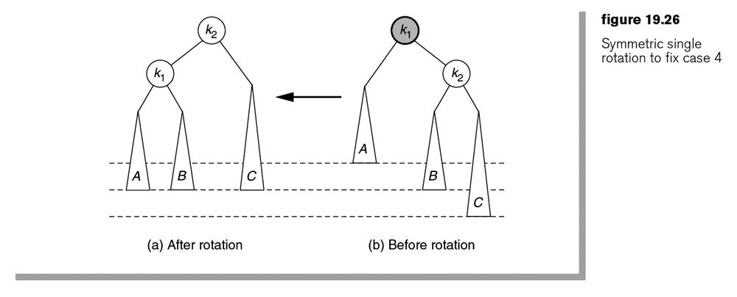
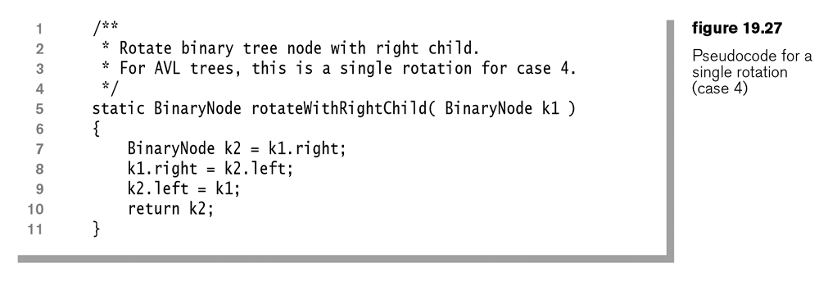
Single Rotation Example 2

Slide 50
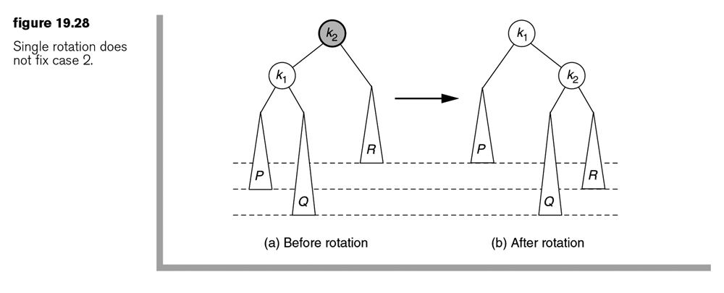
Single Rotation doesn’t fix the 2nd or 3rd cases

Slide 51
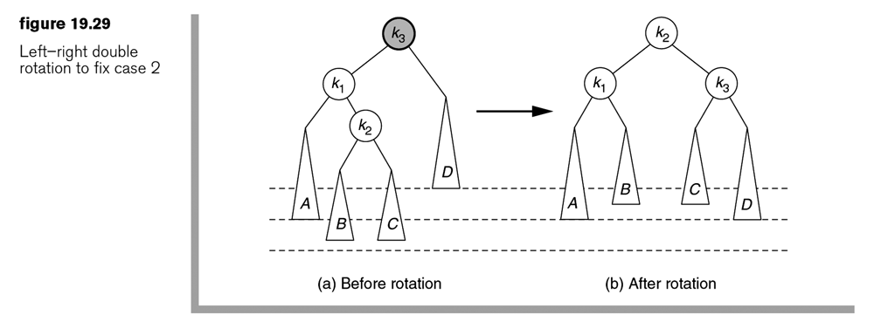
Double Rotation
though a double rotation appears complex, it turns out to be equivalent to the following sequence:
A single rotation between X’s child and grandchild
A single rotation between X and its new child

Slide 52
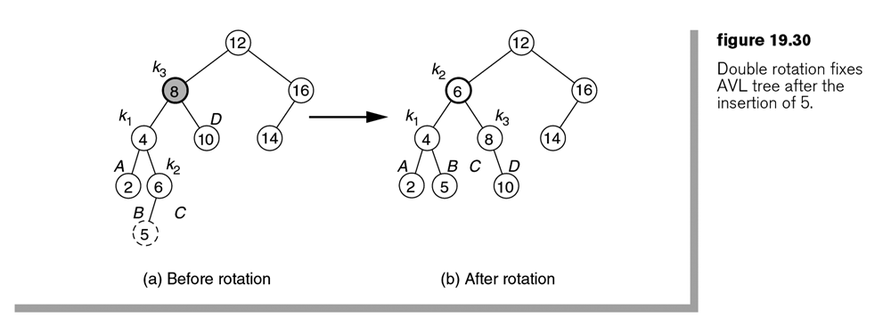
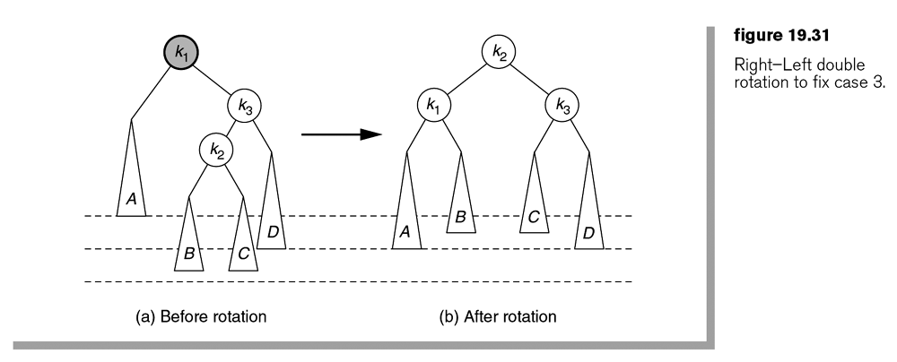
Double Rotation Examples

Slide 53
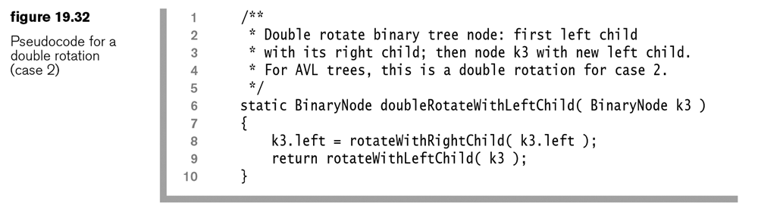
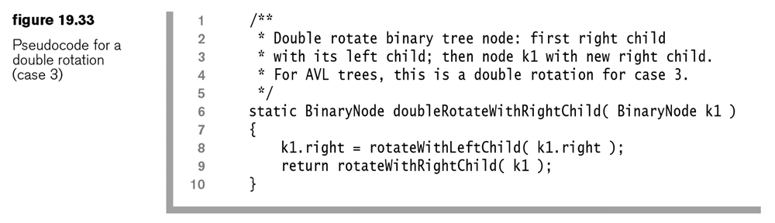
Double Rotation Code

Slide 54
Probably out of time
I don’t think we have time for the following Red/Black trees, but maybe in CS 3000

Slide 55
Summary
Log(n) – awesome
Insert/removal – sometimes a coding bummer
Balancing is a must

Slide 56
Homework – Written
Answer the following questions from the In Theory portion of the book:
19.1 Show the result of inserting 3, 1, 4, 6, 9, 2, 5, and 7 in an initially empty binary search tree. Then show the result of deleting the root.
19.2 Draw all binary search trees that can result from inserting permutations of 1, 2, 3, and 4. How many trees are there? What are the probabilities of each tree’s occurring if all permutations are equally likely?
19.3 Draw all AVL trees that can result from inserting permutations of 1, 2, and 3. How many trees are there? What are the probabilities of each tree’s occurring if all permutations are equally likely?
19.8, Show the result of inserting items 1 through 15 in order in an initially empty AVL tree. Generalize this result (with proof) to show what happens when items 1 through 2k – 1 are inserted into an initially empty AVL tree.
Note: but just the first sentence.

Slide 57
Homework – Programming
Create a java class, or PDF file that answers the following questions:
19.15. Implement find, findMin, and findMax recursively.
Note: I assume that the book wants this for the BinarySearchTree in Figure 19.6. The non-recursive implementations are about Figure 19.9.
19.27. Implement a toString method for class BinarySearchTree. Make sure your method runs in linear time. Hint: Use a private recursive method that has a Node and a StringBuilder as its parameters.
Note: The BinarySearchTree toString() method should actually just return root.toString(). The real recursive work is to make the BinaryNode toString method work recursively. Note that this is an in-order tree traversal. Also note that none of this should be done in private methods. The only reason to use a StringBuilder is to reduce the runtime, so you can use that, or just use the toString() method and concatenate the strings.

Slide 58
Red/Black Trees – Competitor to AVL
AVL insert goes down, then back up to rebalance
This type of tree can insert by just going down the tree
Still O(Log(N))

Slide 59
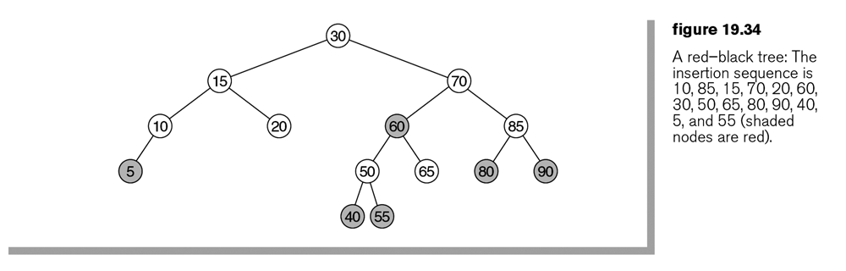
Red/Black Trees
A red–black tree is a binary search tree having the following ordering properties:
Every node is colored either red or black.
The root is black.
If a node is red, its children must be black.
Every path from a node to a null link must contain the same number of black nodes.
Probably should have shaded the black ones instead

Slide 60
The Math to Prove Log(n)
We can show by induction that, if every path from the root to a null node contains B black nodes, the tree must contain at least 2B – 1 black nodes. Furthermore, as the root is black and there cannot be two consecutive red nodes on a path, the height of a red–black tree is at most 2log (N + 1). Consequently, searching is guaranteed to be a logarithmic operation.

Slide 61
Try an insertion
Every node is colored either red or black.
The root is black.
If a node is red, its children must be black.
Every path from a node to a null link must contain the same number of black nodes.
So, we can’t insert a black node, only red
What happens when you insert 25?
How about 3? 8? 99?

Slide 62
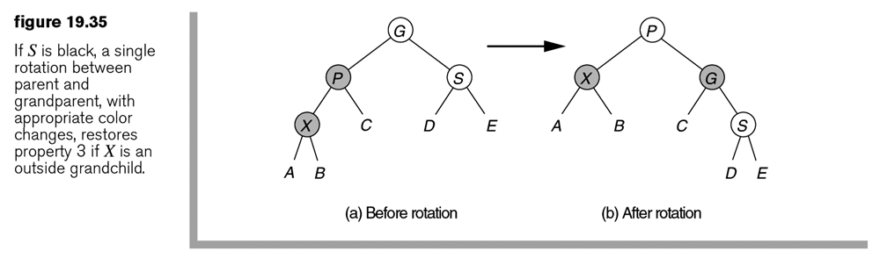
Rotations/Color Changes Parent’s Sibling is Black
We have to consider several cases (each with mirror-image symmetry) if the parent is red. First, suppose that the sibling of the parent is black (we adopt the convention that null nodes are black), which would apply for the insertions of 3 or 8 but not for the insertion of 99. Let X be the newly added leaf, P be its parent, S be the sibling of the parent (if it exists), and G be the grandparent. Only X and P are red in this case; G is black because otherwise there would be two consecutive red nodes prior to the insertion—a violation of property 3. Adopting the AVL tree terminology, we say that relative to G, X can be either an outside or inside node. If X is an outside grandchild, a single rotation of its parent and grandparent along with some color changes will restore property 3. If X is an inside grandchild, a double rotation along with some color changes are needed. The single rotation is shown in Figure 19.35, and the double rotation is shown in Figure 19.36. Even though X is a leaf, we have drawn a more general case that allows X to be in the middle of the tree. We use this more general rotation later in the algorithm.

Slide 63
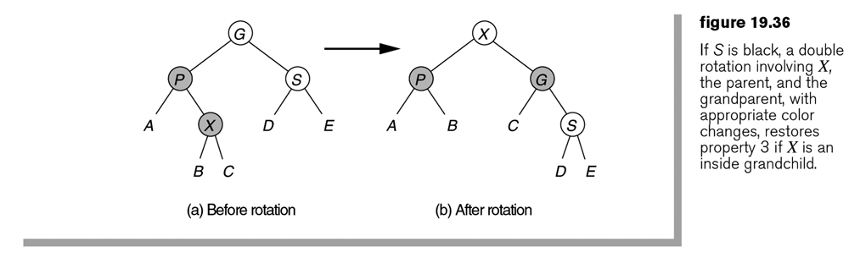
Parent’s Sibling is Still Black

Slide 64
Parent’s Sibling is red
What happens when a 79 is inserted?
Basically we would have to work our way up the tree recoloring, and not have anything better than AVL

Slide 65
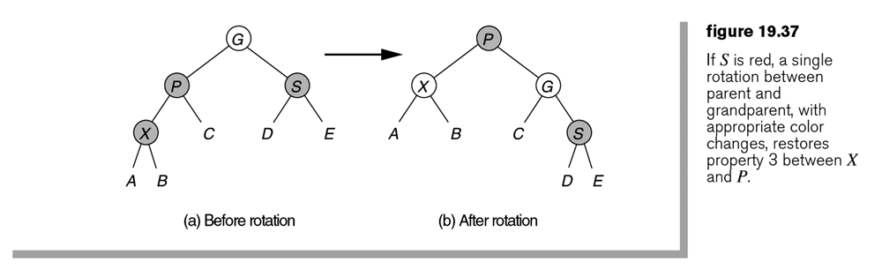
Parent’s Sibling is red

Slide 66
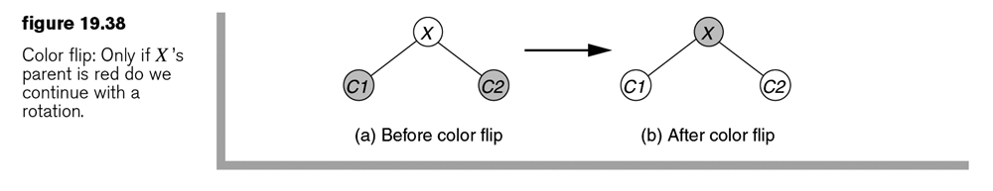
Instead of bottom-up, color top down
On the way down, when we see a node X that has two red children, we make X red and its two children black.
(If X is the root, it will be made red by this process. We could then recolor it back to black, without violating any red–black tree properties.)
However, if X’s parent is red, we would introduce two consecutive red nodes. But in this case, we can apply either the single rotation in Figure19.35 or the double rotation in Figure 19.36.

Slide 67
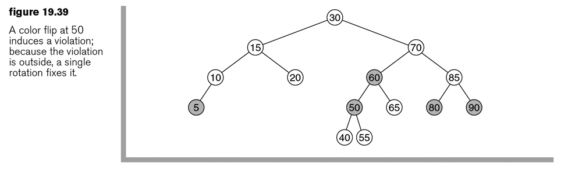
Insert 45
suppose that we want to insert 45 in the tree shown in Figure 19.34. On the way down the tree we see node 50, which has two red children. Thus we perform a color flip, making 50 red and 40 and 55 black. The result is shown in Figure 19.39. However, now 50 and 60 are both red.

Slide 68
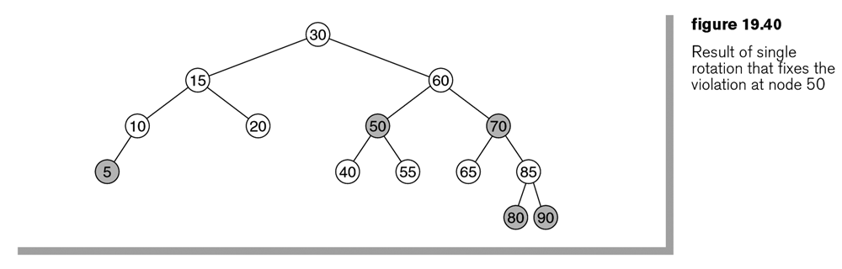
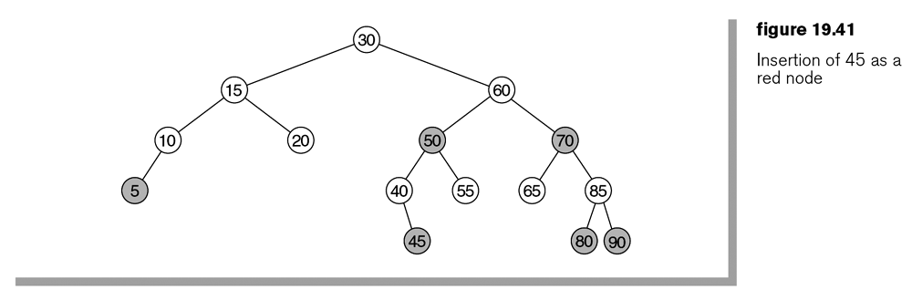
Finishing the insert

Slide 69
Java Implementation
An actual implementation is complicated, not only by many possible rotations, but also by the possibility that some subtrees (such as the right subtree of the node containing 10 in Figure 19.41) might be empty and by the special case of dealing with the root (which, among other things, has no parent). To remove special cases, we use two sentinels.
We use nullNode in place of a null link; nullNode will always be colored black.
We use header as a pseudoroot; it has a key value of –∞ and a right link to the real root.

Slide 70
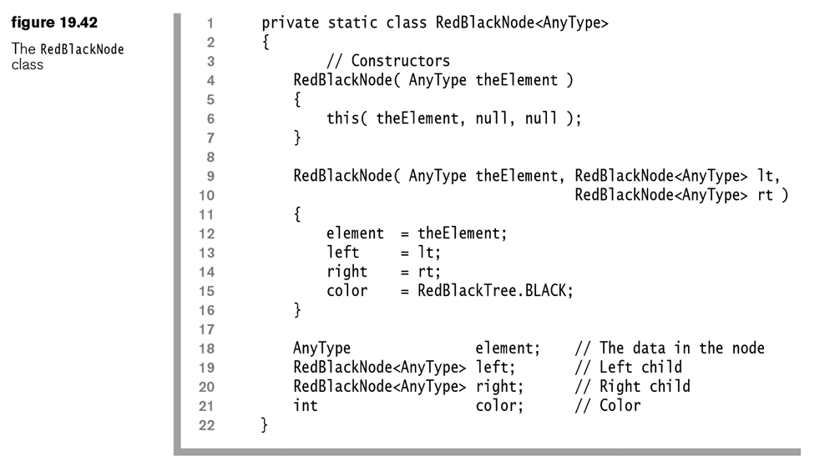

Slide 71
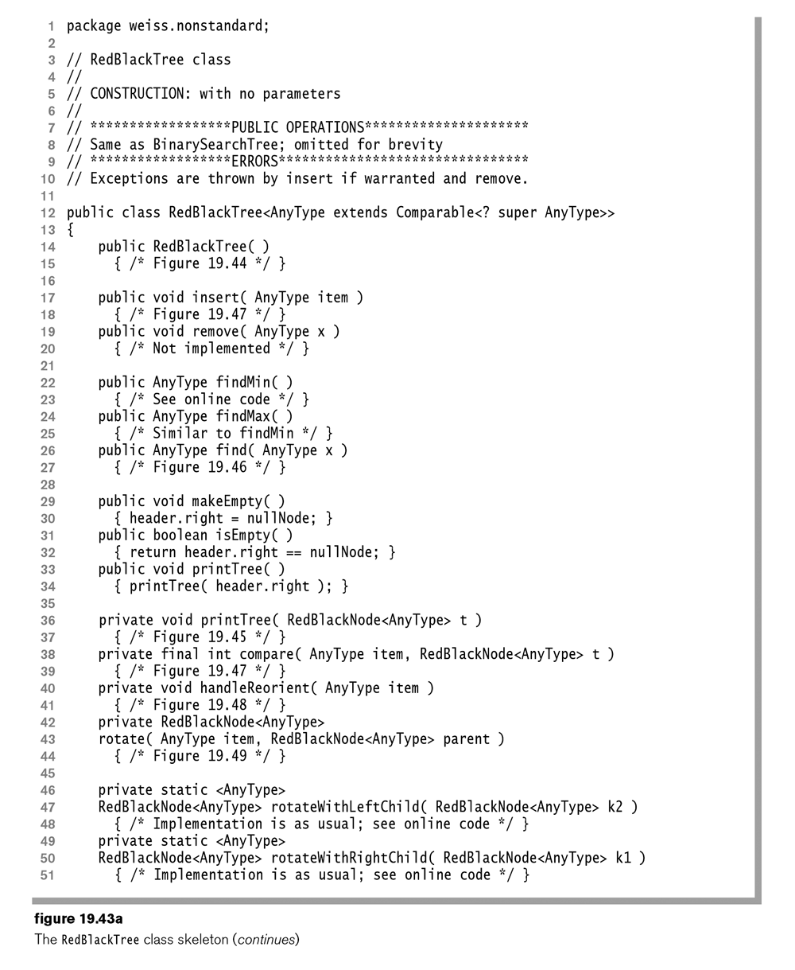

Slide 72
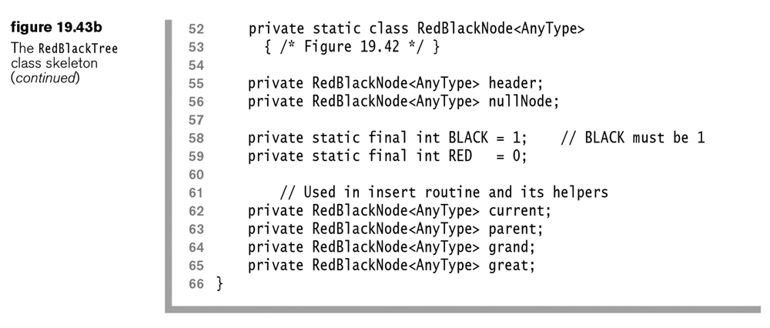

Slide 73
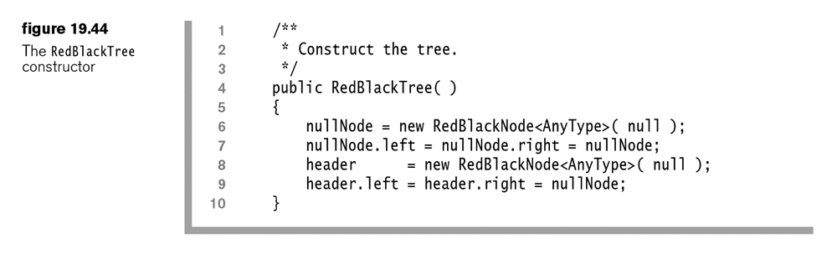

Slide 74
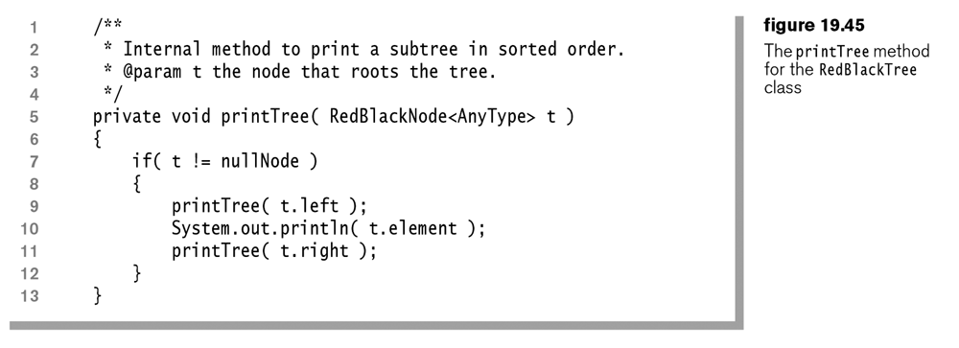

Slide 75
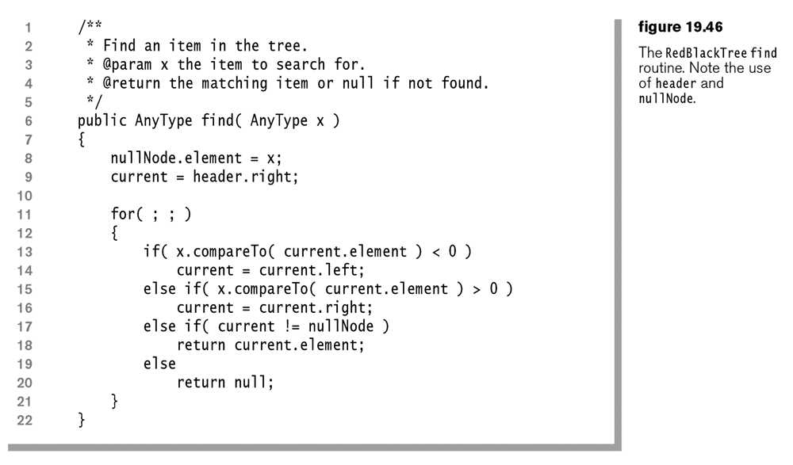

Slide 76
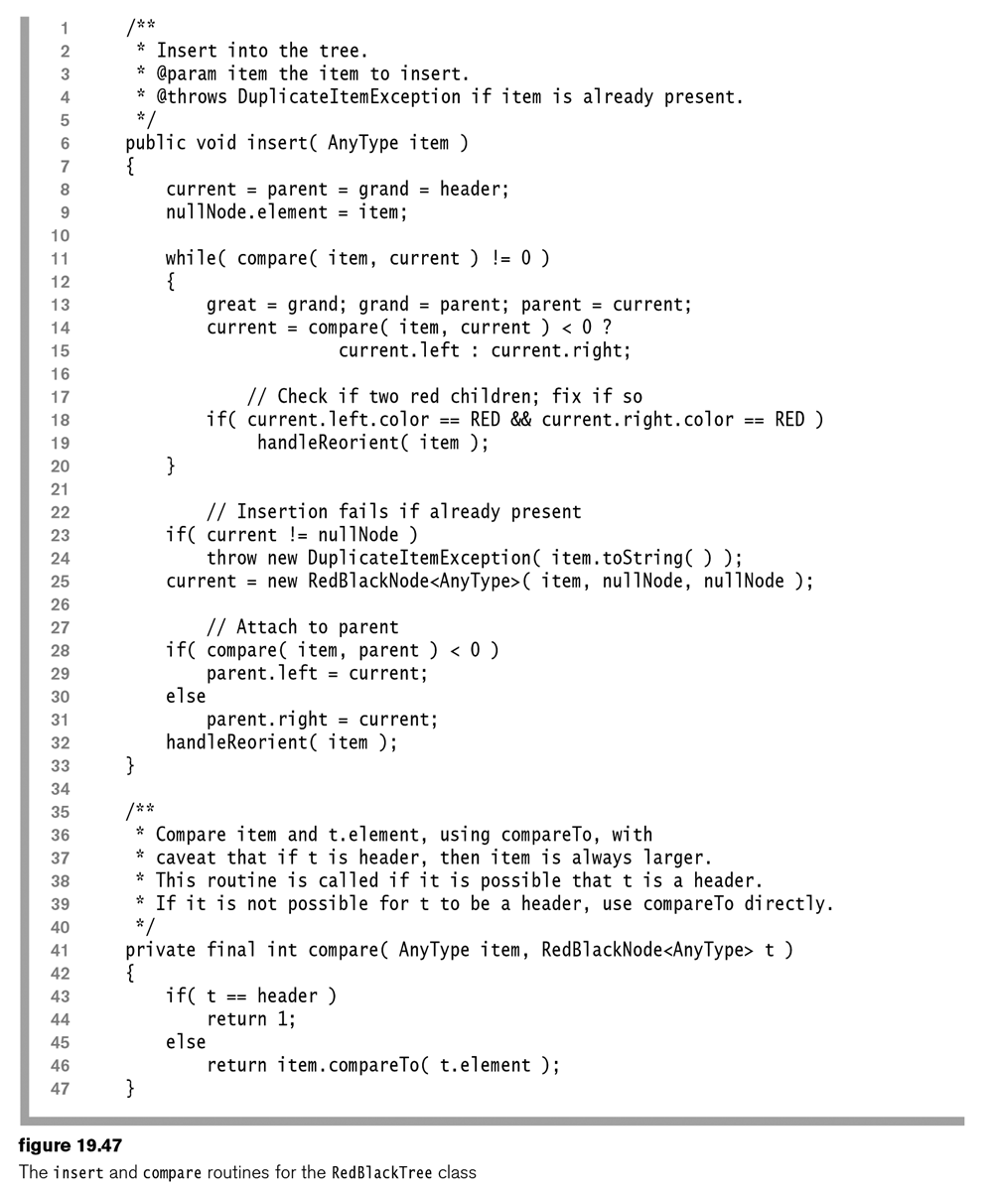

Slide 77


Slide 78


Slide 79
Top Down Deletion
Deletion in red–black trees can also be performed top-down. Needless to say, an actual implementation is fairly complicated because the remove algorithm for unbalanced search trees is nontrivial in the first place.
The normal binary search tree deletion algorithm removes nodes that are leaves or have one child. Recall that nodes with two children are never removed; their contents are simply replaced.
If the node to be deleted is red, there is no problem. However, if the node to be deleted is black, its removal will violate property 4. The solution to the problem is to ensure that any node we are about to delete is red.

Slide 80
X has 2 black Children
Let X be the current node, T be its sibling, and P be their parent. We begin by coloring the sentinel root red. As we traverse down the tree, we attempt to ensure that X is red. When we arrive at a new node, we are certain that P is red (inductively, by the invariant that we are trying to maintain) and that X and T are black (because we cannot have two consecutive red nodes). There are two main cases, along with the usual symmetric variants (which are omitted).
First, suppose that X has two black children. There are three subcases, which depend on T’s children.
T has two black children: Flip colors (Figure 19.50).
T has an outer red child: Perform a single rotation (Figure19.51).
Thas an inner red child: Perform a double rotation (Figure 19.52).

Slide 81




Slide 82

X has a red child
Second, suppose that one of X’s children is red. Because the rotations in the first main case always color X red, if X has a red child, consecutive red nodes would be introduced. Thus we need an alternative solution. In this case, we fall through to the next level, obtaining a new X, T, and P. If we are lucky, we will fall onto a red node (we have at least a 50 percent chance that this will happen), thereby making the new current node red. Otherwise, we have the situation shown in Figure 19.53. That is, the current X is black, the current T is red, and the current P is black.

Slide 83
Eventually
X is a leaf, which is always handled by the main case since X has two black children.
X has only one child, for which the main case applies if the child is black, and if it is red, we can delete X, if necessary, and make the child black.

Slide 84
AA trees
Because of many possible rotations, the red–black tree is fairly tricky to code. In particular, the remove operation is quite challenging. In this section we describe a simple but competitive balanced search tree known as an AA-tree. The AA-tree is the method of choice when a balanced tree is needed, a casual implementation is acceptable, and deletions are needed. The AA-tree adds one extra condition to the red–black tree: Left children may not be red.

Slide 85
AA trees
To simplify the implementation further, we represent balance information in a more direct way. Instead of storing a color with each node, we store the node’s level. The level of a node represents the number of left links on the path to the nullNode sentinel and is
Level 1, if the node is a leaf
The level of its parent, if the node is red
One less than the level of its parent, if the node is black

Slide 86

AA trees
A horizontal link is a connection between a node and a child of equal levels. The coloring properties imply
Horizontal links are right links (because only right children may be red)
There may not be two consecutive horizontal links (because there cannot be consecutive red nodes)
Nodes at level 2 or higher must have two children
If a node does not have a right horizontal link, its two children are at the same level

Slide 87


Slide 88


Slide 89


Slide 90


Slide 91


Slide 92


Slide 93


Slide 94


Slide 95


Slide 96


Slide 97


Slide 98


Slide 99


Slide 100


Slide 101


Slide 102


Slide 103


Slide 104


Slide 105


Slide 106


Slide 107


Slide 108


Slide 109


Slide 110


Slide 111


Slide 112


Slide 113


Slide 114


Slide 115


Slide 116


Slide 117


Slide 118
B-Trees
So far, we have assumed that we can store an entire data structure in the main memory of a computer. Suppose, however, that we have more data than can fit in main memory, and, as a result, we must have the data structure reside on disk. When that happens, the rules of the game change, because the Big-Oh model is no longer meaningful.
We have 500 million instructions versus 120 disk accesses. Put another way, one disk access is worth about 4,000,000 instructions.
10,000,000 items, that each key is 32 bytes (representing a name), and that a record is 256 bytes. We assume that this data set does not fit in main memory and that we are 1 of 20 users on a system (so we have 1/20 of the resources). Thus in 1 sec. we can execute 25 million instructions or perform six disk accesses.
The unbalanced binary search tree is a disaster. In the worst case, it has linear depth and thus could require 10,000,000 disk accesses.
On average a successful search would require 1.38 log N disk accesses, and as log 10,000,000 is approximately 24, an average search would require 32 disk accesses, or 5 sec. In a typical randomly constructed tree, we would expect that a few nodes are three times deeper; they would require about 100 disk accesses, or 16 sec. A red–black tree is somewhat better at 4 seconds

Slide 119
Solution? More Branching
An M-ary search tree allows M-way branching, and as branching increases, the depth decreases. Whereas a complete binary tree has height that is roughly log₂ N, a complete M-ary tree has height that is roughly log_{M} N.

Slide 120

B-Tree
A B-tree of order M is an M-ary tree with the following properties.
The data items are stored at leaves.
The nonleaf nodes store as many as M – 1 keys to guide the searching; key i represents the smallest key in subtree i + 1.
The root is either a leaf or has between 2 and M children.
All nonleaf nodes (except the root) have between ⎡M/2⎤ and M children.
All leaves are at the same depth and have between ⎡L/2⎤ and L data items, for some L (the determination of L is described shortly).

Slide 121


Slide 122


Slide 123


Slide 124


Slide 125


